Slide 1

NYC TAXI TRIP TIME PREDICTION
R.L.SOUMYA-221FA14033

Slide 2
CONTENT
Introduction
Problem statement
Data summary
Exploratory Data Analysis (EDA)
Feature Engineering & Selection
Building and Evaluating Model
Conclusion

Slide 3
INTRODUCTION
In New York City, due to traffic jams, construction or road blockage etc. user will need to know how much time it will take to commute from one place to other.
Increasing popularity of app-based taxi such as ola or uber and there competitive pricing levels made user decisive to choose based on trip pricing and duration.
Taxi Drivers also have to choose best route having lesser trip time.
So here we will be building a model which will be predicting the trip duration of taxies running in NewYork. This prediction will help customers to select the taxi based on trip duration and driver to select optimum route to their destination.

Slide 4
PROBLEM STATEMENT
We have the dataset Which is based on the 2016 NYC Yellow Cab trip record data made available in Big Query on the Google Cloud Platform. The data was originally published by the NYC Taxi and Limousine Commission (TLC). The data was sampled and cleaned for the purposes of this project. Based on individual trip attributes, we should predict the duration of each trip in the test set.

Slide 5
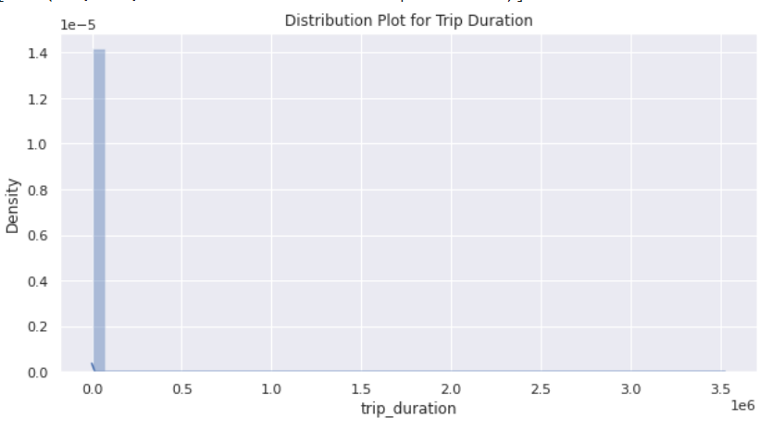
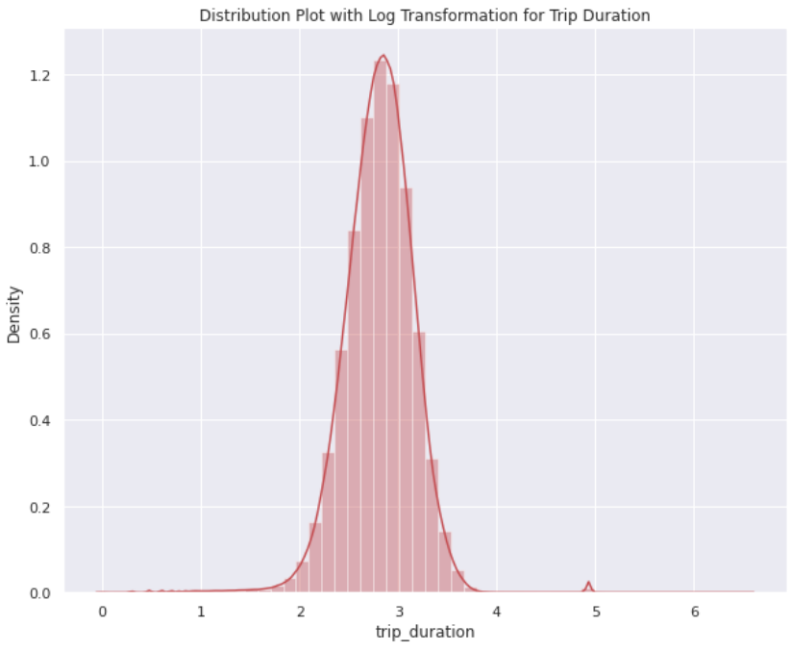
TRIP DURATION DATA ANALYSIS

Slide 6
DATA SUMMARY
id - a unique identifier for each trip
vendor_id - a code indicating the provider associated with the trip record
pickup_datetime - date and time when the meter was engaged
dropoff_datetime - date and time when the meter was disengaged
passenger_count - the number of passengers in the vehicle (driver
entered value)
pickup_longitude - the longitude where the meter was engaged
pickup_latitude - the latitude where the meter was engaged
dropoff_longitude - the longitude where the meter was disengaged
dropoff_latitude - the latitude where the meter was disengaged
store_and_fwd_flag - This flag indicates whether the trip record was held in vehicle memory before sending to the vendor because the vehicle did not have a connection to the server - Y=store and forward; N=not a store and forward trip
trip_duration - duration of the trip in seconds

Slide 7
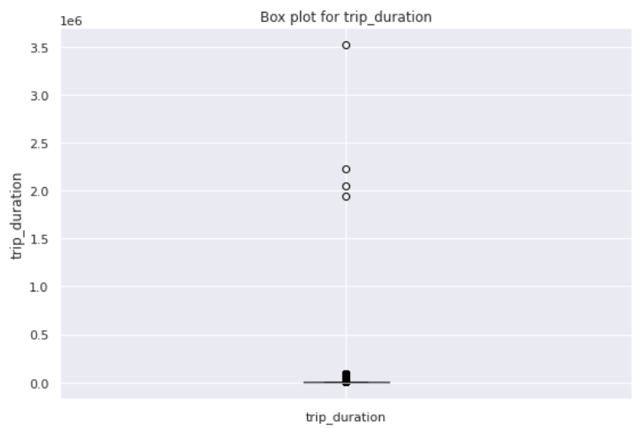
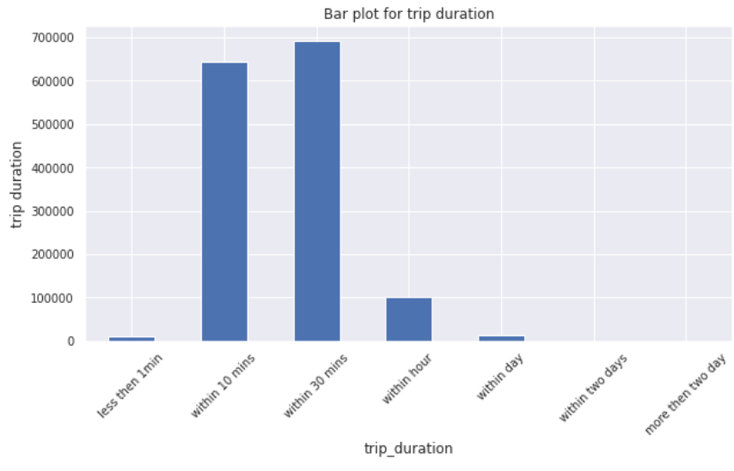
TRIP DURATION DATA ANALYSIS
From the figure above we can conclude that most of the trip are general for 10 min to 1 hour.

Slide 8
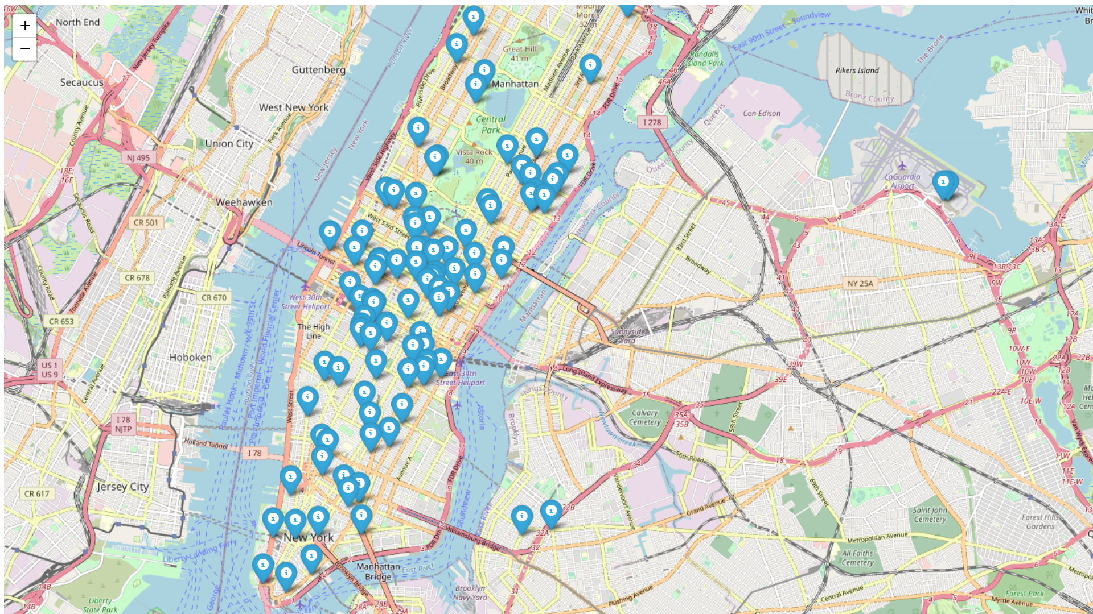
Distribution of Pickup Latitude and longitude

Slide 9
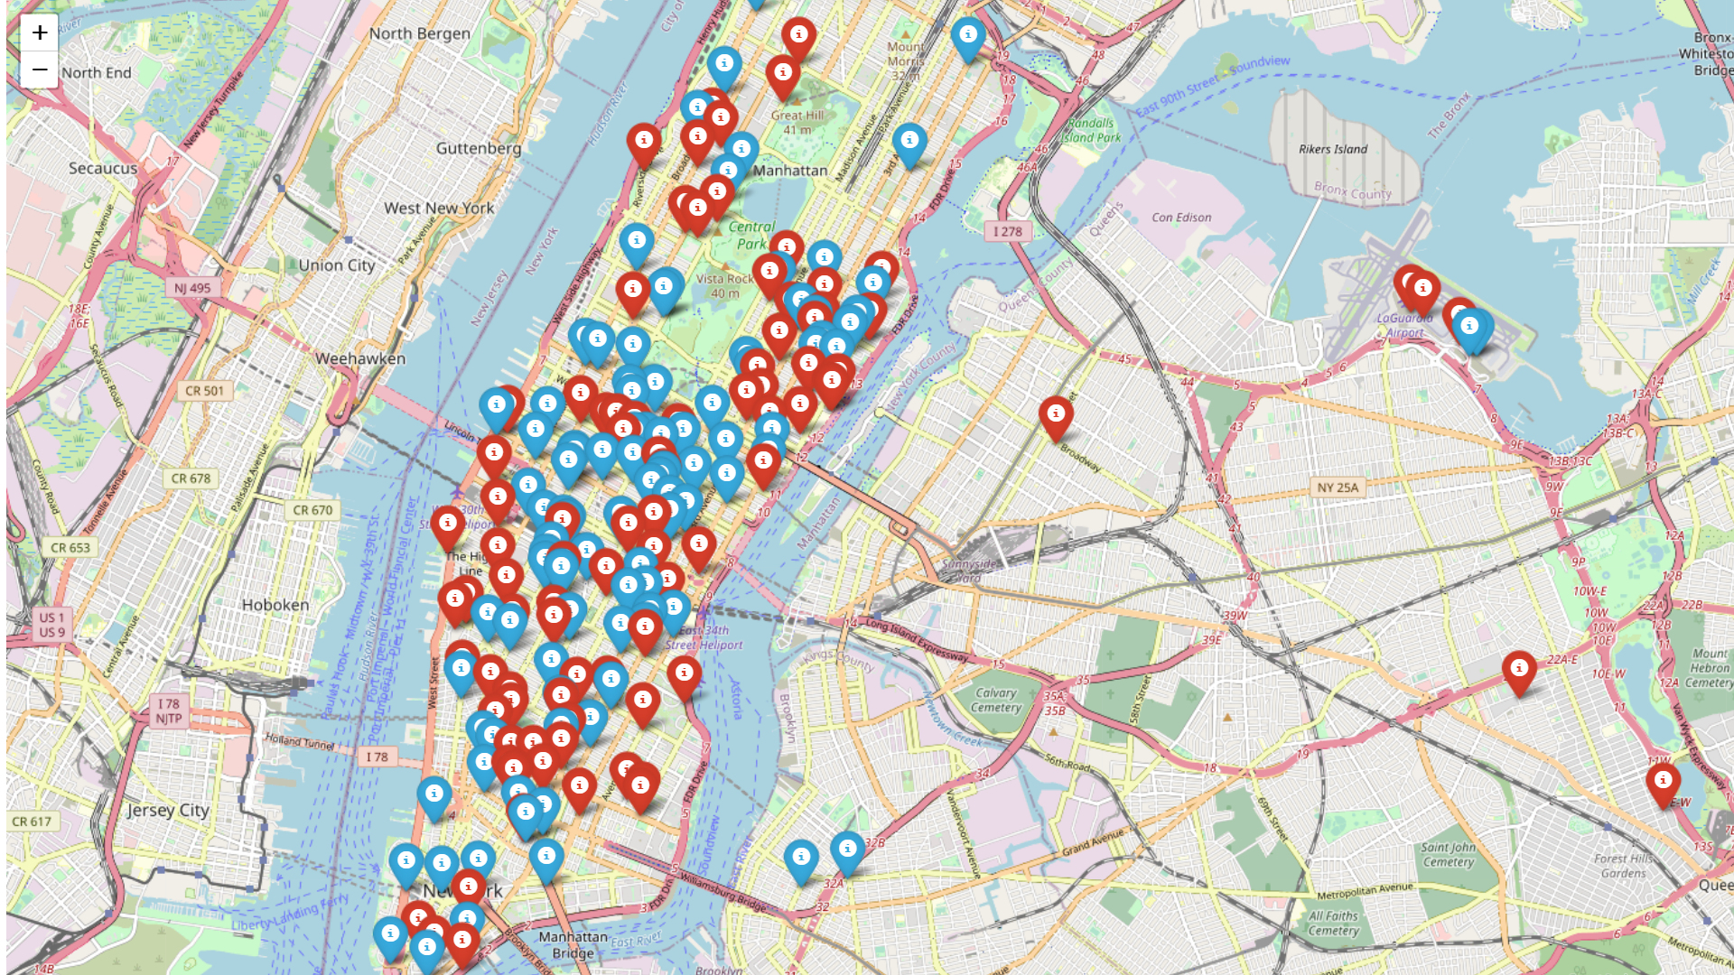
Distribution of Dropoff Latitude and longitude

Slide 10
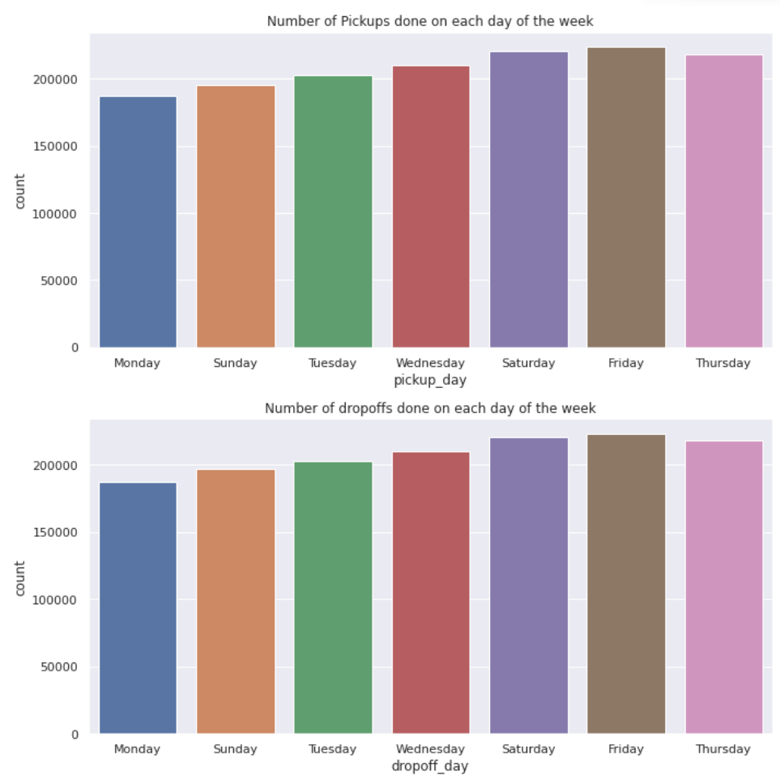
Number of Pickups and Drop-offs with in a Week

Slide 11
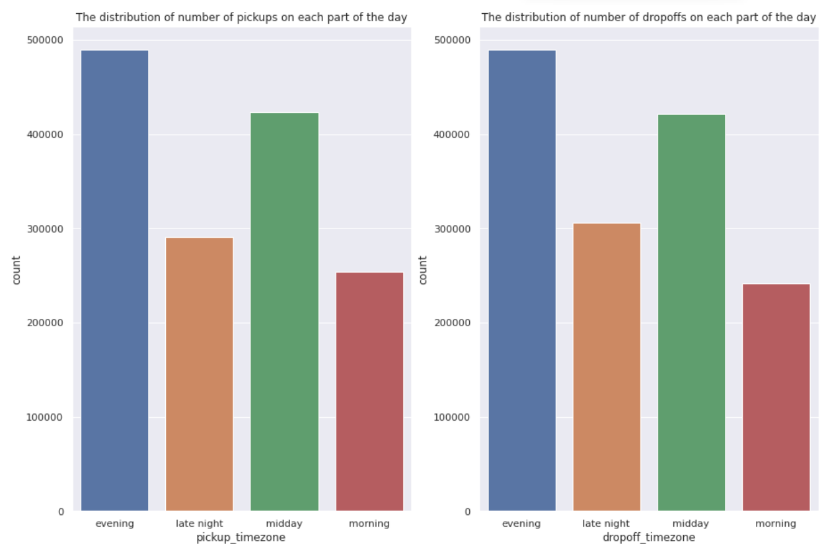
Number of Pickups and Drop-offs with in a Day

Slide 12
BASIC EXPLORATION
The dataset contains 1458644 rows and 11 columns.
Two categorical features ‘store_and_fwd_flag’ and ‘vendor_id’
Outliers present in all numerical features
Data formating steps required for datetime features
No null values present
Passenger_count, Vendor_id and trip_duration are having integer value.
pickup_datetime,dropoff_datetime is a datetime variable
pickup_longitude,pickup_latitude,dropoff_longitude,dropoff_latitude
are real numbers having float as data type *store_and_fwd_flag
and Id belongs to a string data type.

Slide 13
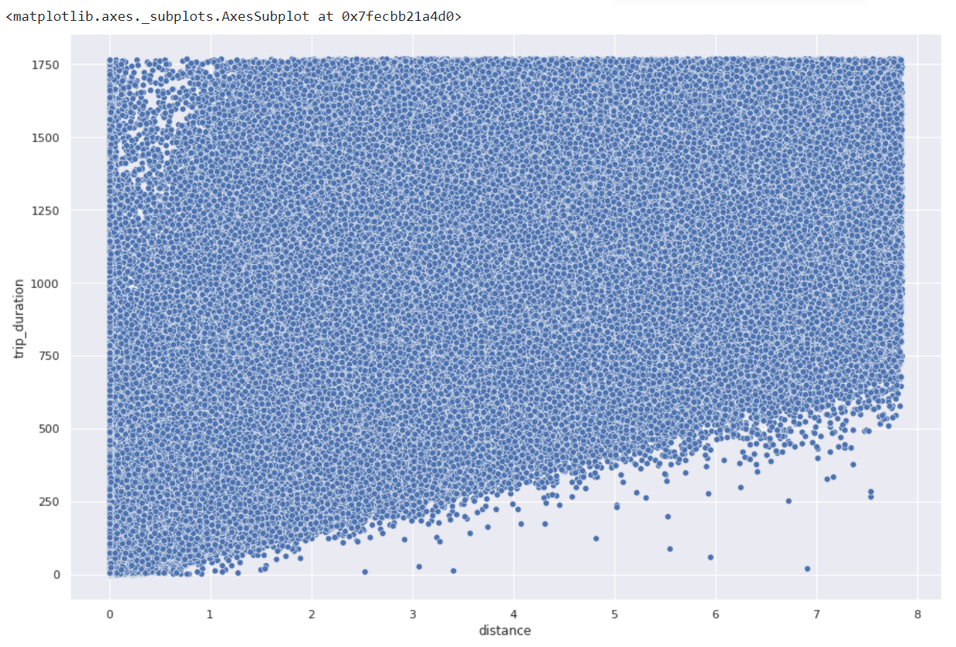
Relation Between Trip duration and Distance

Slide 14
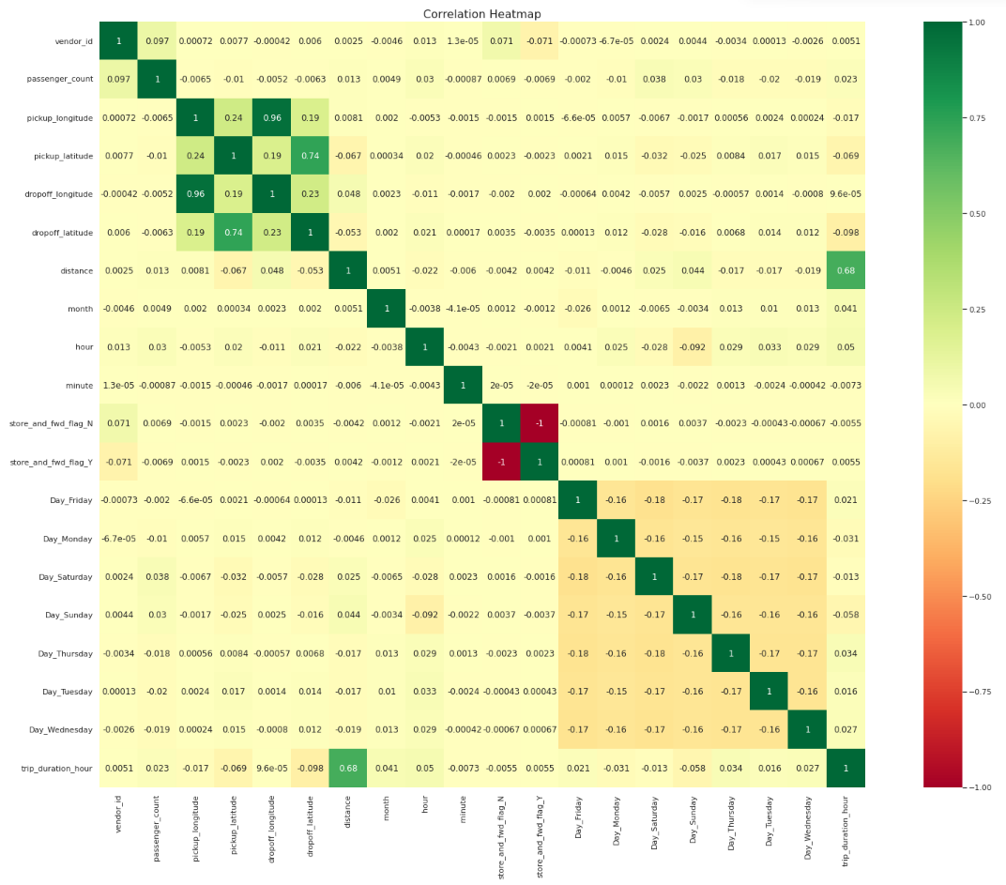
Correlation Heatmap

Slide 15
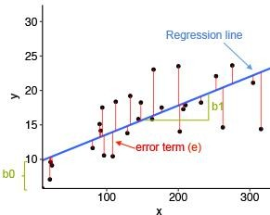
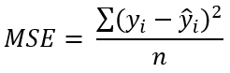
Linear Regression
Linear Regression is a regression of dependent variable on independent variable. It is a linear model that assumes a linear relationship between dependent
(y) and independent variables (x). The dependent variable (y) is calculated by l inear combination of independent variable (x).
y=b₀+b₁ x₁ +b₂x₂
The cost function for linear regression is given by:
Mean of sum of square error
MSE | 72764.0061
RMSE | 269.748041
R2 | 0.484766
Adjusted_R2 | 0.484758
Where:
y_{i} is the i^{th} observed value.
ŷ_{i} is the corresponding predicted value.
n = the number of observations.

Slide 16
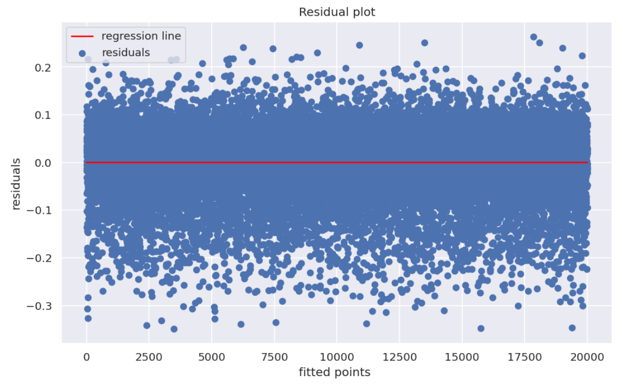
Homoscedasticity check

Slide 17
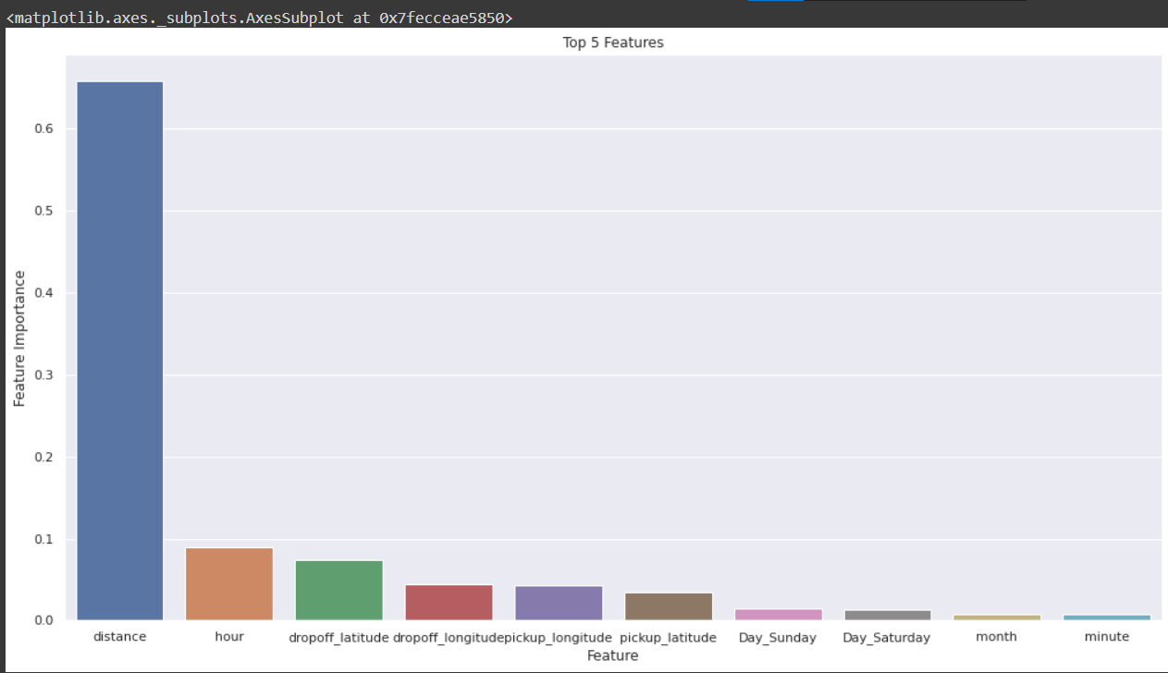
Feature Importance

Slide 18
Final Metrics Conclusion
Algorithms | Test MSE | Test RMSE | Test R2 | Train Adjusted R2
Linear Regression | 0.005472 | 0.073978 | 0.495791 | 0.495312
Lasso Regression | 0.005470 | 0.073965 | 0.495963 | 0.495484
Ridge Regression | 0.005470 | 0.073965 | 0.495966 | 0.495486
Decision Tree Regressor | 0.004235 | 0.065081 | 0.609772 | 0.609401
XGB Regressor | 0.003144 | 0.056076 | 0.710290 | 0.710014
Gradient Boosting | 0.003121 | 0.055870 | 0.712415 | 0.712142
Light GBM | 0.003418 | 0.058470 | 0.685021 | 0.684722
Reference
R2-score: Usually must be between 0 and 1, towards 1 considered as good fit.
RMSE: [Value] <= 0.1146 (Null RMSLE - A Benchmark to Achieve)

Slide 19
Conclusion
In this project, we tried to predict the trip duration of a taxi in NYC.
We are mostly concerned with the information of pick up latitude and longitude and drop off latitude and longitude, to get the distance of the trip.
Hyperparameter tuning doesn’t improve much accuracy.
Linear regression gives 60.89 % accuracy,XGBoost gives 68.56% accuracy, LightGBM gives 71.42% on the test set.
LightGBM is more fitter and efficient than XGBoost for taxi trip duration-based predictions
LightGBM will be the best model to predict the trip duration for a particular taxi.

